Slide 1
Undulator 1 Pulsed-wire alignment

Slide 2
Wire Position 1
x1,y1 denote positions of post on entrance side. X2,y2 denote positions of post on exit side.
X1,y1 = (12, 18)
X2, y2 = (11, 12)
Use “xtraj vs yoffset” and “ytraj vs xoffset” wirescans to measure magnetic axis along undulator
Use velocity signal (flat) to calibration amplitude vs voltage.

Slide 3
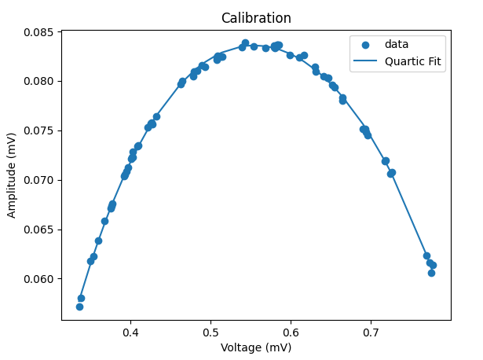
Calibration
Non-flat trajectories will sample voltages outside the linear region.
Calibration curve allows us to correct for this error afterwards.
Error in calibration data is <0.5%

Slide 4
Frequency Lowpass Filter
One laser/photodiode pair has a very large signature at 50kHz.
I have implemented a low pass filter where frequencies above a specified cutoff are set to zero amplitude.
This introduces noise near the edges of the signal
1-2 percent of full window
Doesn’t affect measurement in the middle.

Slide 5
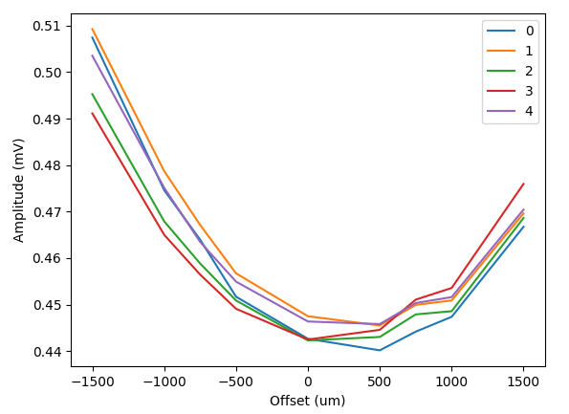
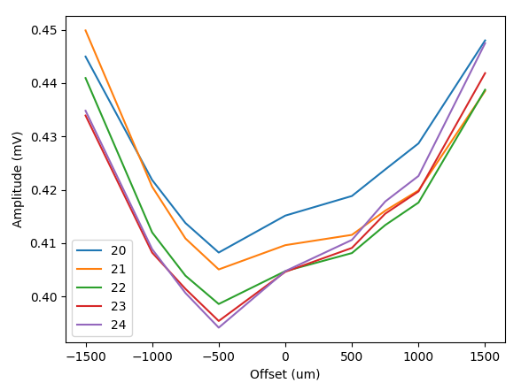
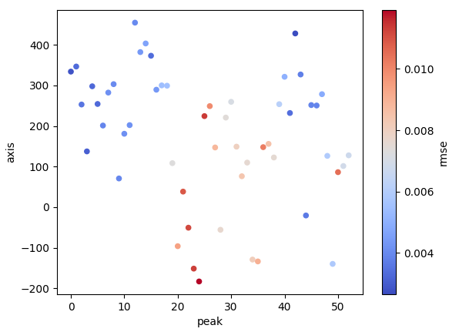
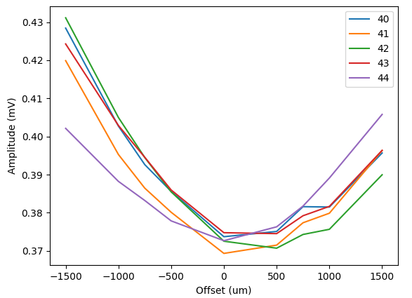
Dec 19: Xtraj vs Yoffset
First 5 peak concavities look very nice!
Graph shows magnetic axis along undulator with color showing the error in quadratic fit.
Fit with line, weights given by 1/rmse
Suggested wire adjustment:
yP1 = 470um
yP2 = 100um

Slide 6
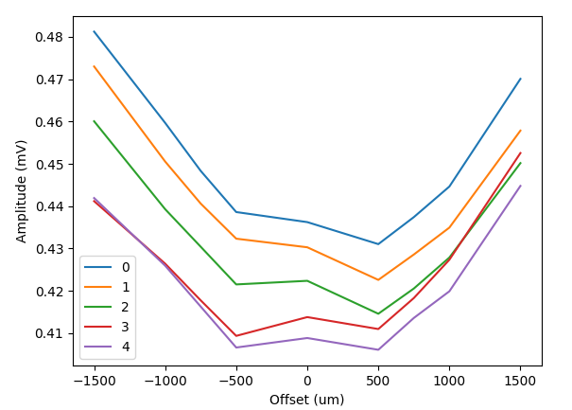
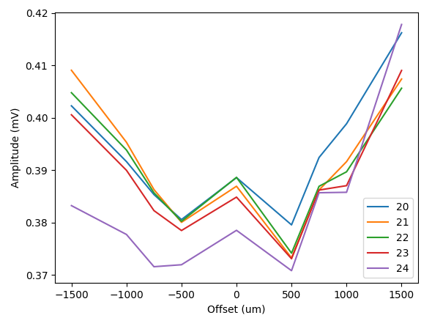
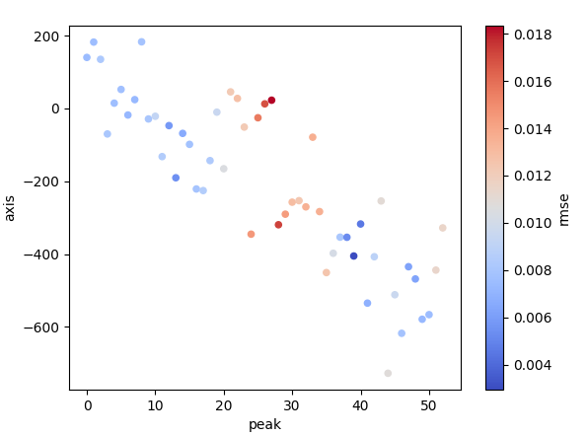
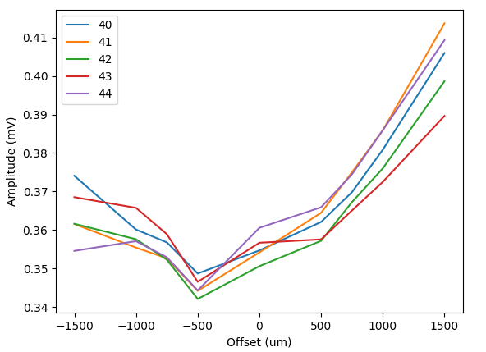
Dec 21: Ytraj vs Xoffset
Nice linear trend for magnetic axis vs xoffset.
Suggested wire adjustment:
xP1 = 970um
xP2 = -850um
Not surprised there is more noise
Noise to signal ratio was 3x larger than for xtraj.
Should these results be trusted?

Slide 7
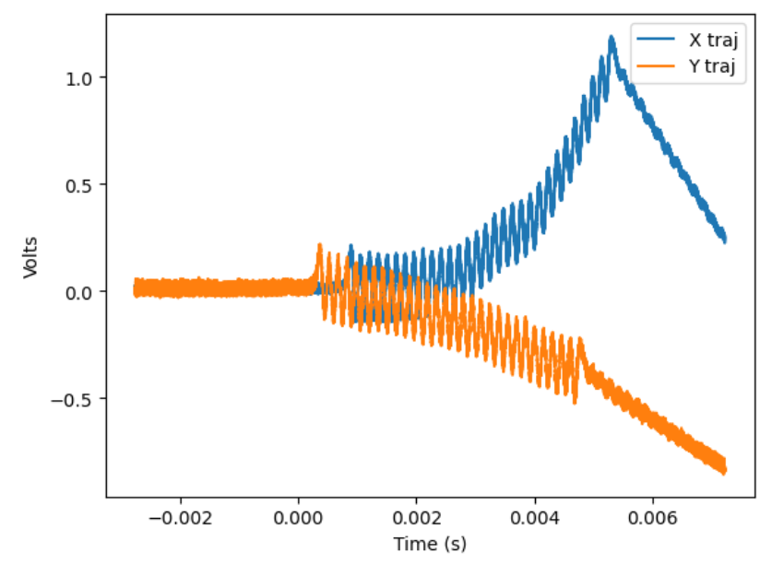
Wire Position 2
Old Positions:
X1,y1 = (12, 18)
X2, y2 = (11, 12)
Adjustments:
xP1 = 970um
yP1 = 470um
xP2 = -850um
yP2 = 100um
New Positions:
X1,y1 = (12.97, 18.47)
X2, y2 = (10.15, 12.10)
Trajectories after moving to new location
Y trajectory looks good
X trajectory has a little concavity for first 60% of undulator. I do not like the kick around t=4ms…

Slide 8
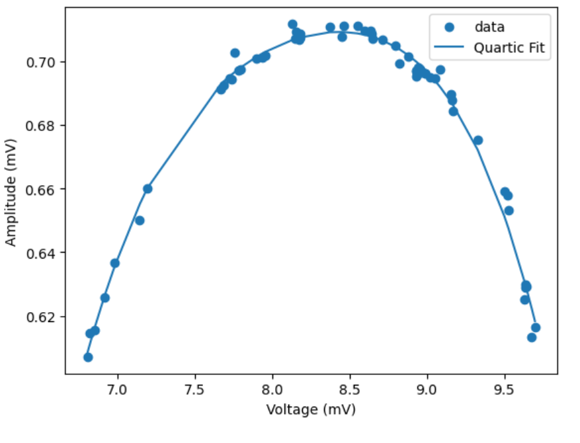
Dec 21: Xtraj vs Xoffset
Have to tune trajectory straightish with entrance magnet to have measurement be feasible.
Tried again, still failed to get good results

Slide 9
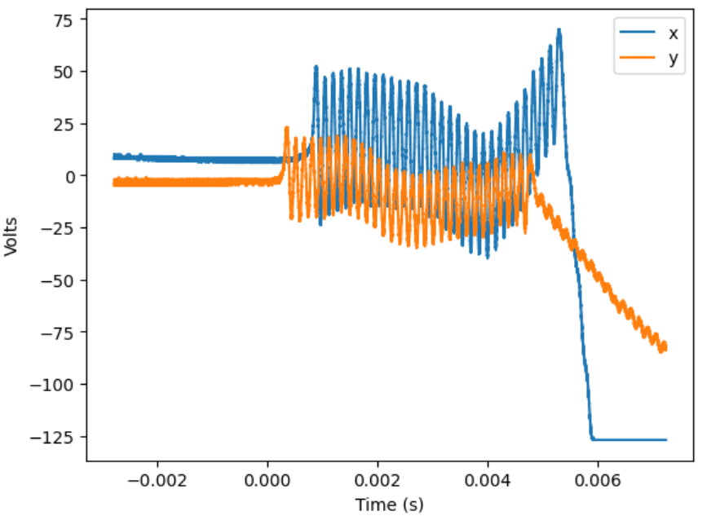
Straighten X manually
Old Positions:
X1,y1 = (12.97, 18.47)
X2, y2 = (10.15, 12.10)
Adjustments:
xP2 = 1.0
New Positions:
X1,y1 = (12.97, 18.47)
X2, y2 = (11.15, 12.10)
My impression playing around the x position at both posts is that the kick at t=4ms is not being fixed, just masked..
Deductions:
By magnet, more likely to slip during movement than Bx magnet?
21th x minimum???
If kick at minimum, a positive, downward By field

Slide 10
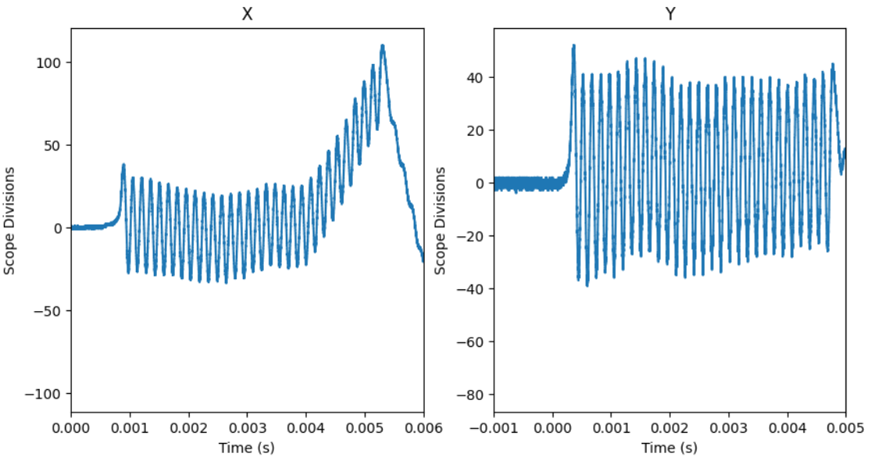
Position so trajectories straight until kick
Positions:
X1,y1 = (12.97, 18.47)
X2, y2 = (10.65, 12.10)
Just adjust xP2=.5mm from Wire Position 2.

Slide 11
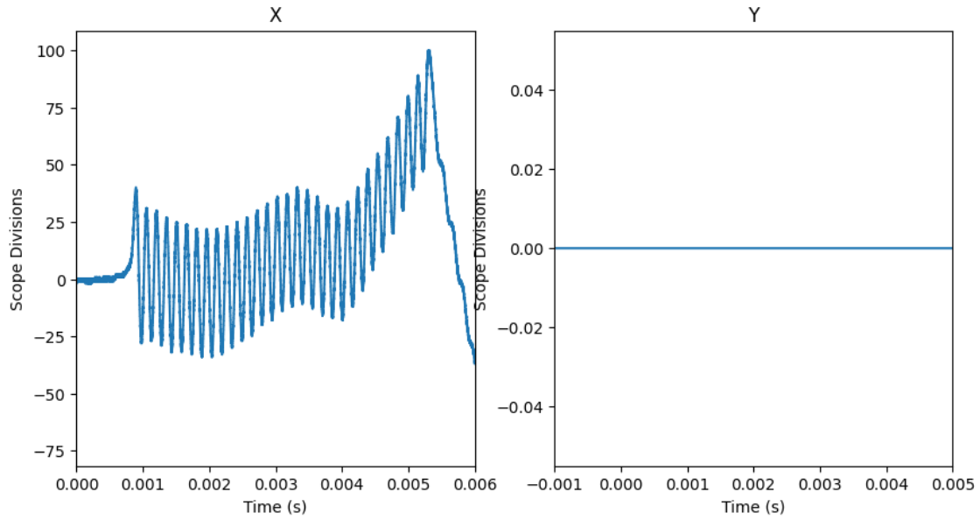
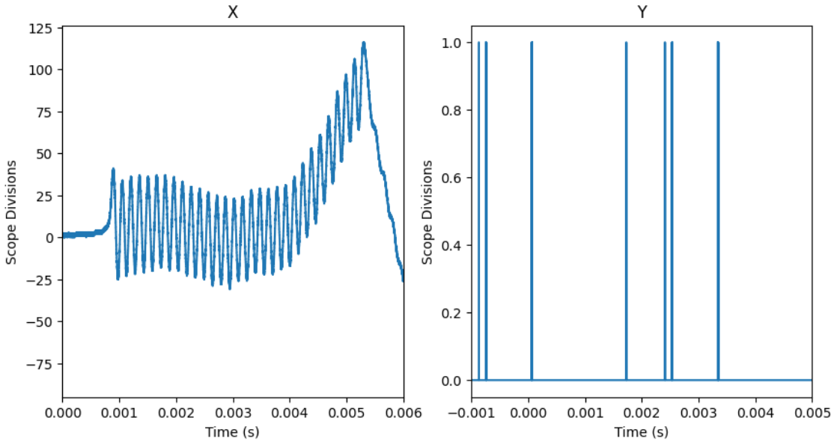
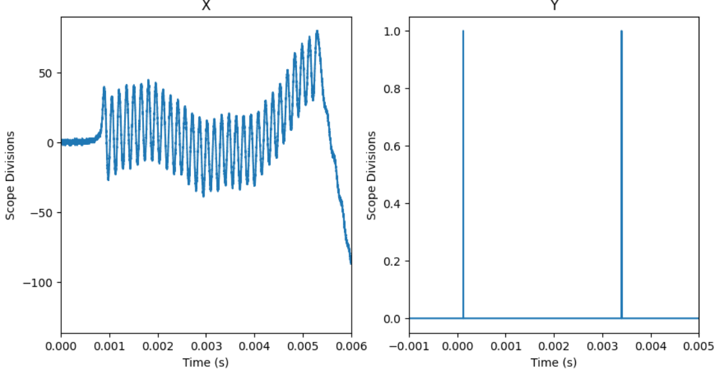
Move Wire up and Down
Original is shown with x and y trajectories.
Pics above are wire moved up .5mm steps
Pics below are wire moved down .5mm steps.
Suggests magnet on top slipped?
NS magnet can only slip closer to axis
Kick would be from N magnet on top or S magnet on bottom.
Kick occurs at trajectory minima
Looks like 21 minima or 22nd N (top)/S(bottom pair
This restricts us to T80 (North), check against hall probe tuning.
Were T79-T81 tuned recently?

Slide 12
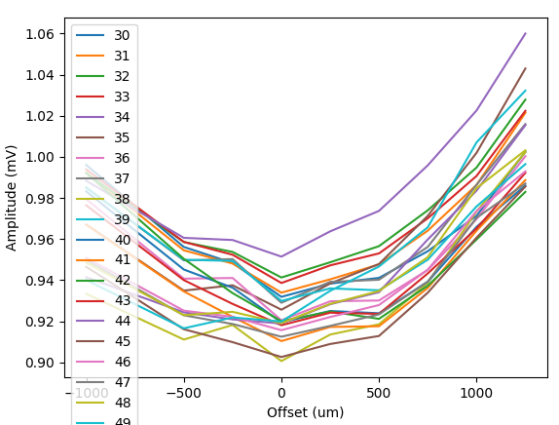
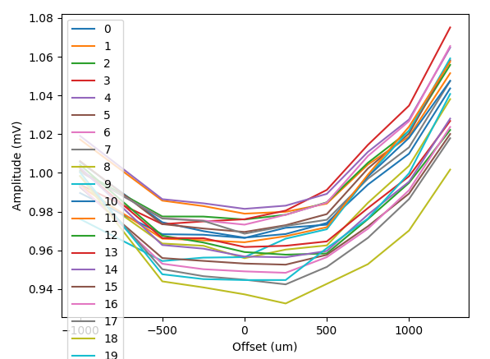
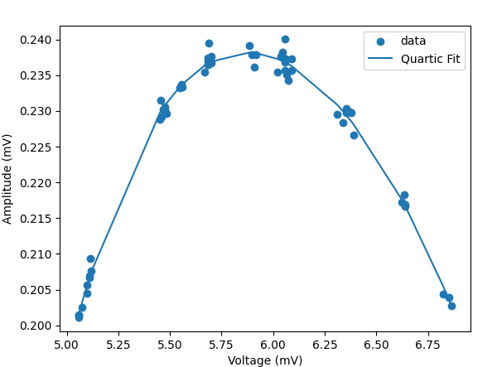
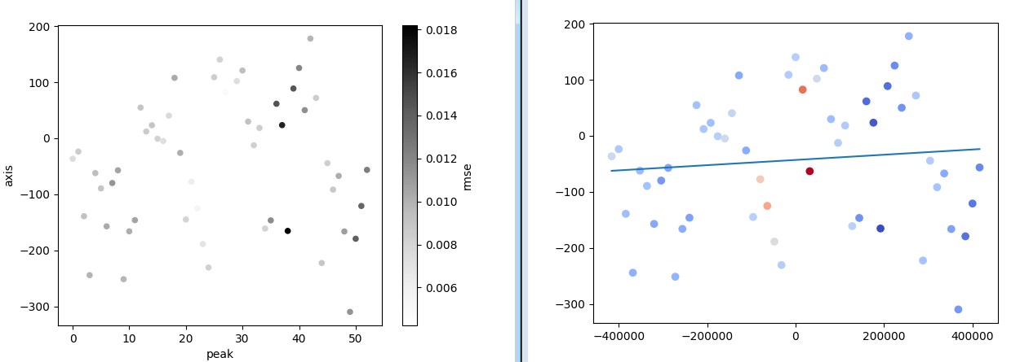
Wirescan (12-28 xtraj vs yoffset)
Clean looking concavities!
Axes of peaks are within +/- 150um and we are centered for the most part.

Slide 13
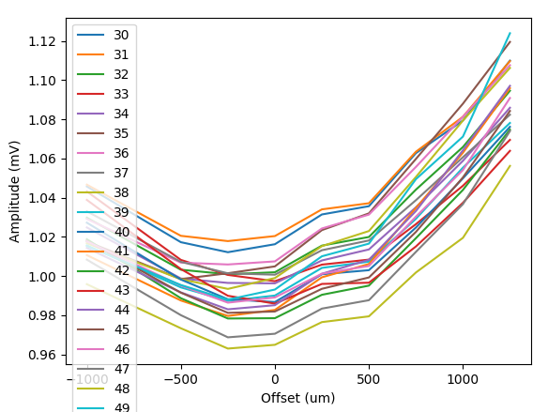
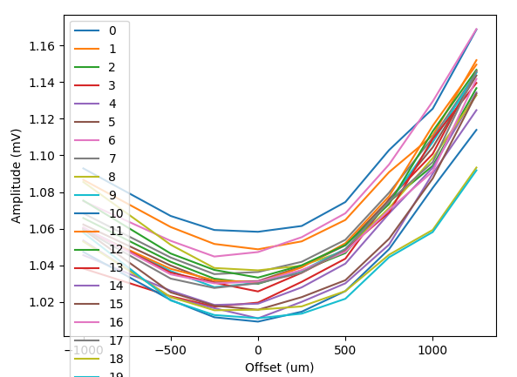
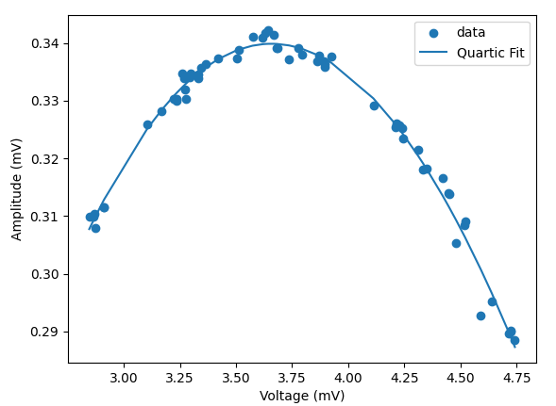
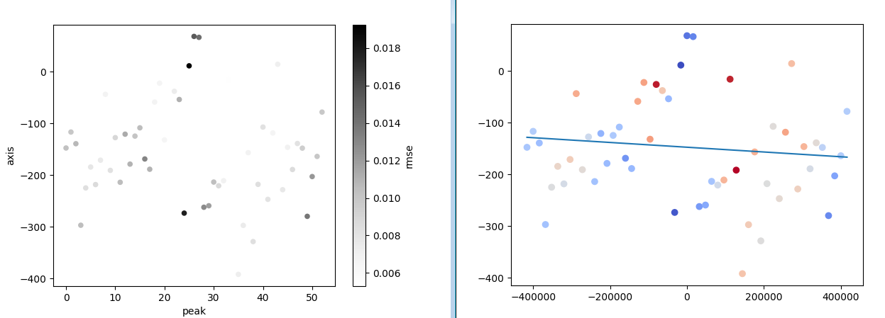
Wirescan (12-28 ytraj, xoffset)
Clean concavities!
Axes are grouped within +/- 150um.

Slide 14
X traj vs Y offset
Positions:
X1,y1 = (12.97, 18.47)
X2, y2 = (10.65, 12.10)
Moved -.15mm in x, -.05 mm in y
New Positions: (currently final positions)
X1,y1 = (12.85, 18.45)
X2, y2 = (10.5, 12.05)

Slide 15
After doing X traj vs Y offset Jan 19
It suggested moving -50 in y.
Now we are at:
X1,y1 = (12.85, 18.40)
X2, y2 = (10.5, 12.00)

